Slide 1

EMPLOYEE RETENTION USING DATA SCIENCE
JB INSTITUTE OF ENGINEERING AND TECHNOLOGY
UGC AUTONOMOUS
(ACCREDITED BY NAAC &NBA, APPROVED BY AICTE &PERMANENTLY AFFILIATED TO JNTUH)
DEPARTMENT OF ELECTRONICS AND COMPUTER ENGINEERING(ECM)
A MINI PROJECT ON:
PRESENTED BY: SUHAS AITHAM, ECM-18671A1903

Slide 2
ABSTRACT
Now a day's data science predictions are used in IT industries, for the improvement in market investment, employee management etc.
Retention of valuable employees within an organization has become an important issue as it is hard to find out the reasons that why employees are leaving an organization and keep them satisfied is a big challenge, for this a report is made to predict the retention of an employee in an organization using the python programming with data science methods.
The main idea of this report is to find out that which valuable employee will leave the company and the features which are affecting him/her to making this decision like salary level, no. of hours spending in a week, promotion, no. of work accident etc.
The application was developed in python programming language and prediction are made with the help of data science and machine learning models.

Slide 3
INTRODUCTION
Data mining is the next big in the world of Information Technology, usage of data extraction is increasing day by day.
Data science is the process of mining of useful insights from larger amount of data to use it for the development purpose.
To extract data several algorithms, methods and analyzing processes are used depending upon the kind of data we have and what the analyst intended to do with the data.
The data we get is in the form of raw data, it needs to get preprocessed to make it in the form to apply algorithm on it.

Slide 4
Existing System
In Existing , Rupesh Khare, Dimple Kaloya and Gauri Gupta et.al , proposed that a risk equation can be developed, which can be used to assess attrition risk with current set of employees that a company is having.
They concluded by stating that among the various attrition predictive techniques available in the market, Logistic Regression and K-Nearest Neighbour are the closest to give a solution which produced highly accurate results.

Slide 5
Disadvantages
But the retention is unknown, which is predicted, is not Satisfied to highly accurate results.

Slide 6
Proposed System
The main idea of this report is to find out that which valuable employee will leave the company and the features which are affecting him/her to making this decision like salary level, no. of hours spending in a week, promotion, no. of work accident etc.
The application was developed in python programming language and prediction are made with the help of data science and machine learning models.
The design criteria and the implementation details are presented in this report.

Slide 7
Advantages
It also helps in finding the exact reasons which are motivating the employees for shifting companies like lower salary, less promotions or heavy work load etc.
To find the result in the form of yes or no, we have used logistic regression method, which predicts result in binary values that are 0 or 1, 0 means employee will not leave the company and 1 means he/she will.

Slide 8
SYSTEM REQUIREMENTS:
SOFTWARE REQUIREMENTS
Operating System : Windows 10
Python IDE : python 3.2.7,pycharm
HARDWARE REQUIREMENTS
RAM : 4GB and Higher
Processor : i3processor
Hard Disk : 500GB

Slide 9
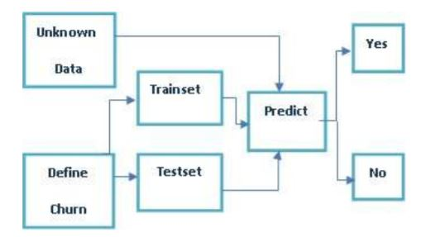
System Architecture

Slide 10
Dataset
Source: Kaggle
https://www.kaggle.com/pavansubhasht/ibm-hr-analytics-attrition-dataset

Slide 11
Python Libraries
NumPy: Base n-dimensional array package
SciPy: Fundamental library for scientific computing
Matplotlib: Comprehensive 2D/3D plotting
IPython: Enhanced interactive console
Sympy: Symbolic mathematics
Pandas: Data structures and analysis
Extensions or modules for SciPy care conventionally named SciKits

Slide 12
Algorithms
Random Forest Classifier
Decision Tree
MLP Classifier
Voting Classifier
KNN(Nearest Neighbor)

Slide 13
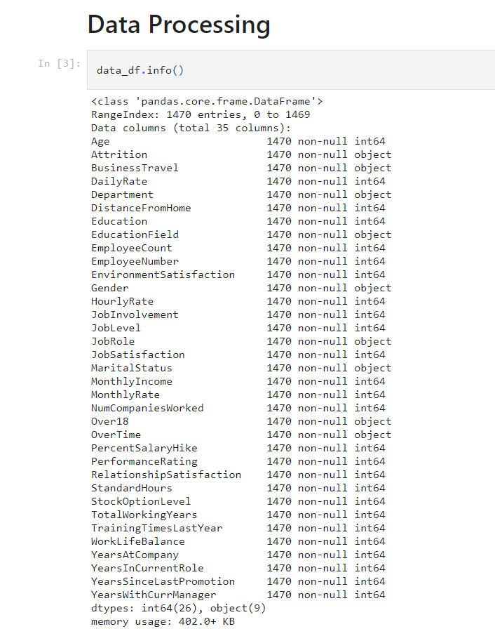
Data Summary

Slide 14
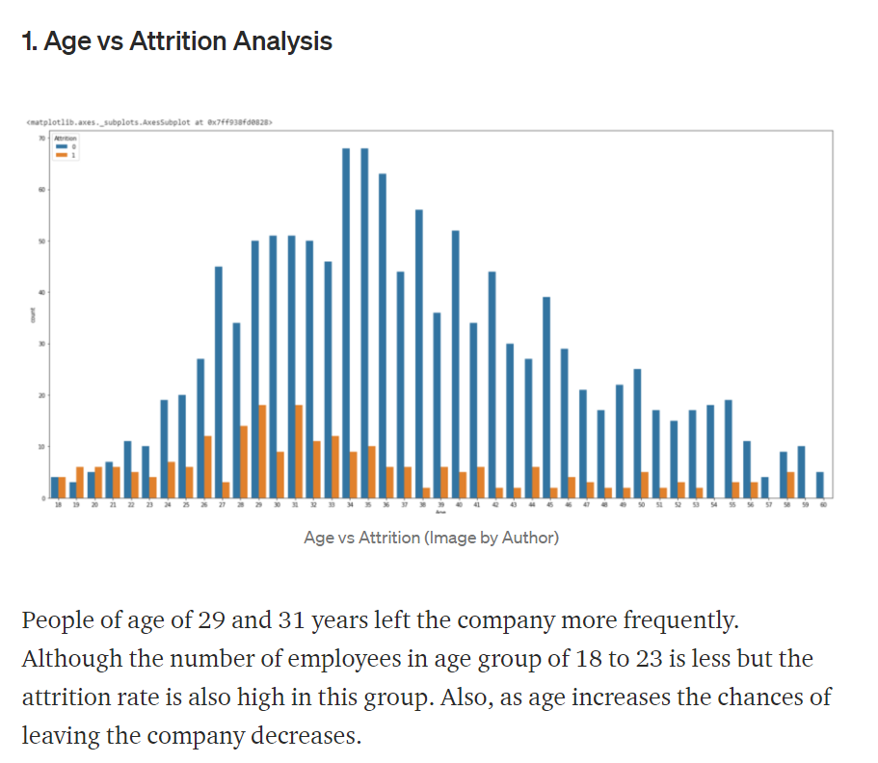
Age vs Attrition Analysis

Slide 15
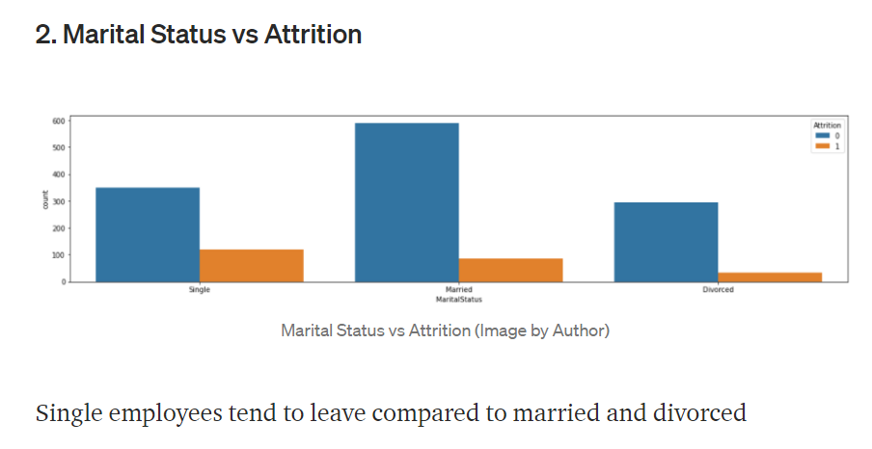
Marital Status vs Attrition

Slide 16
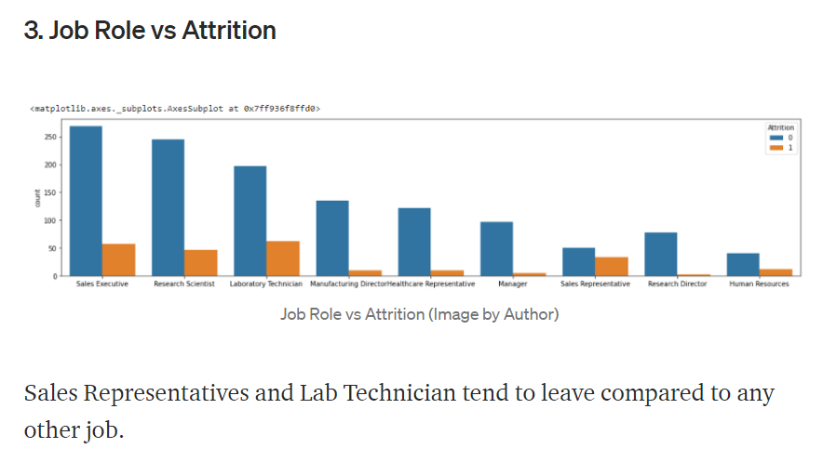
Job Role vs Attrition

Slide 17
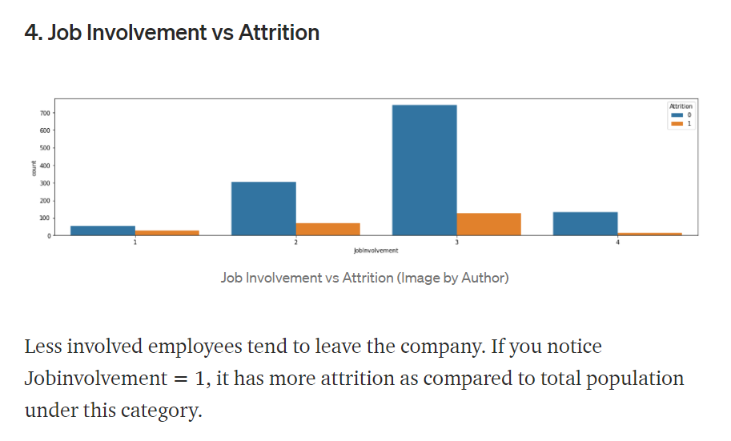
Job Involvement vs Attrition

Slide 18
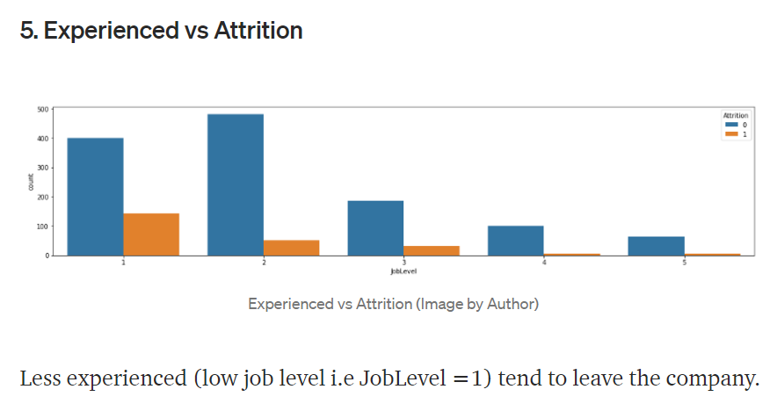
Experienced vs Attrition

Slide 19
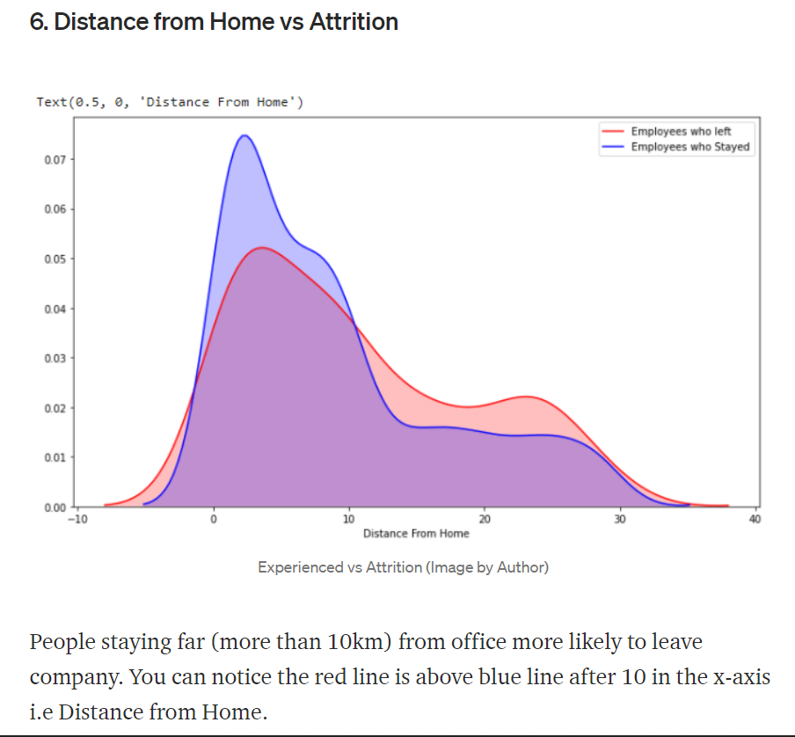
Distance from Home vs Attrition

Slide 20
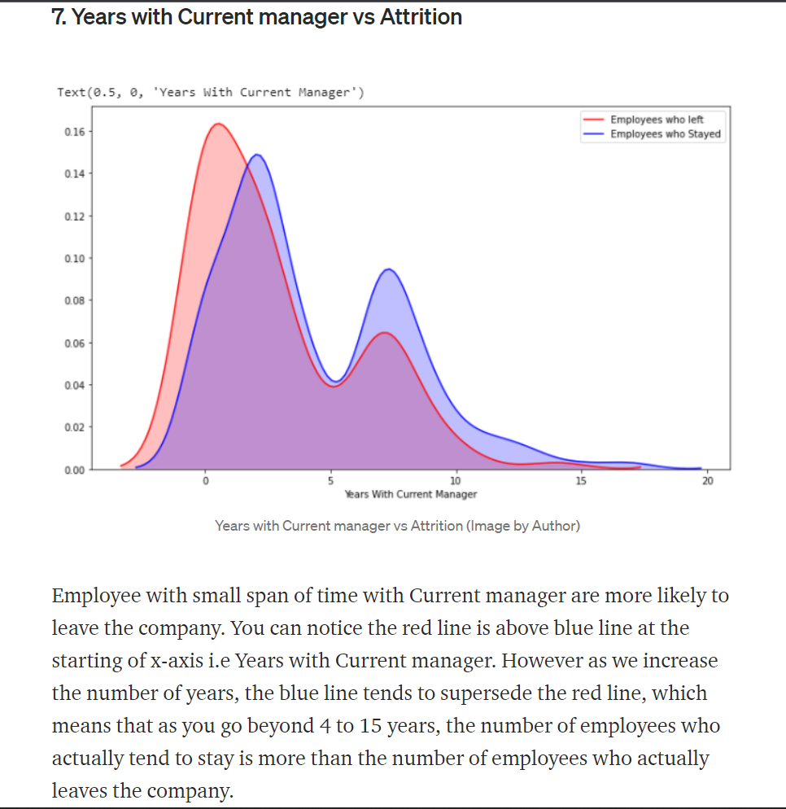
Years with Current Manager vs Attrition

Slide 21
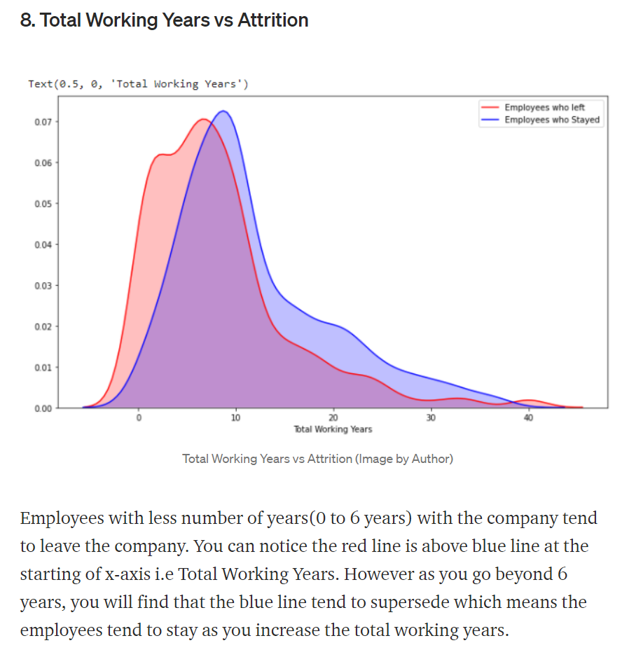
Total Working Years vs Attrition

Slide 22
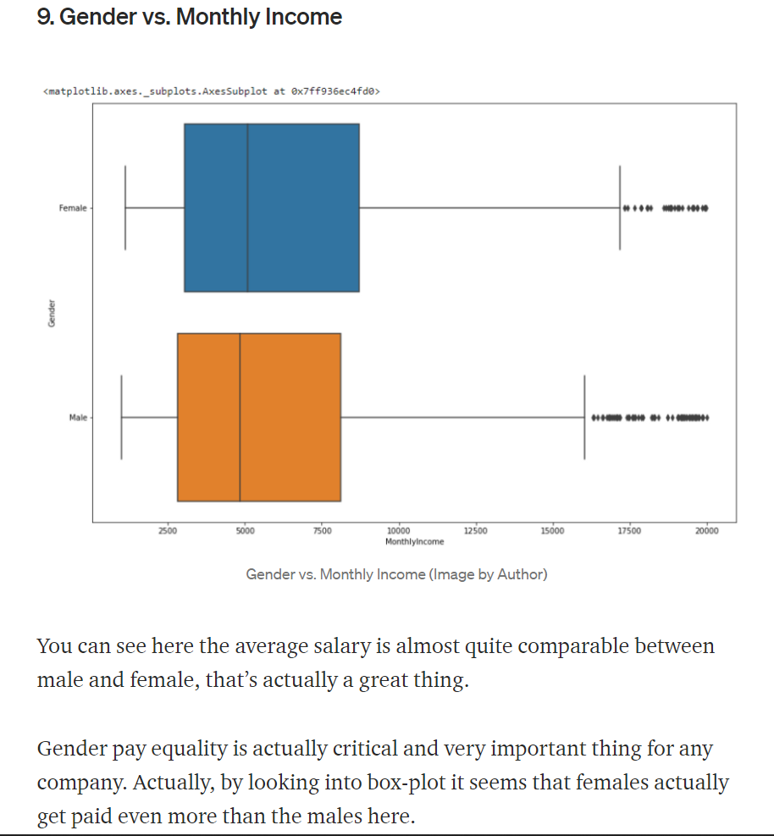
Gender vs Monthly Income

Slide 23
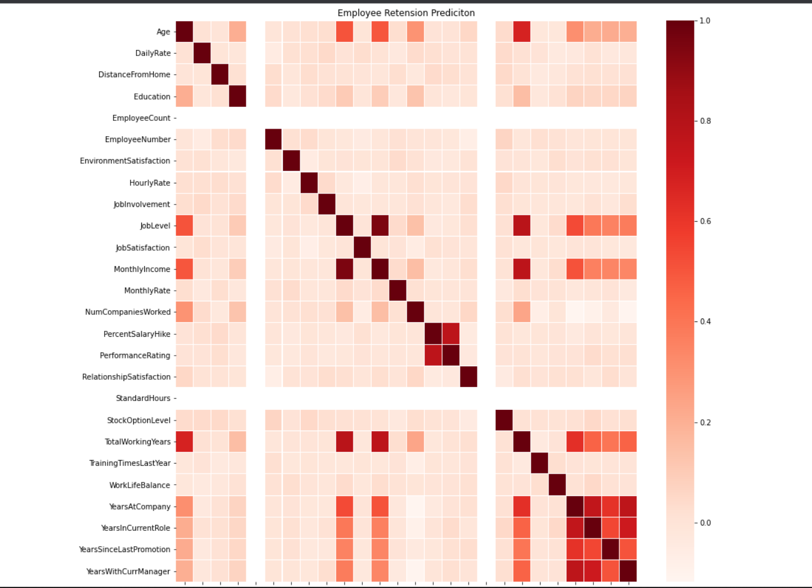

Slide 24
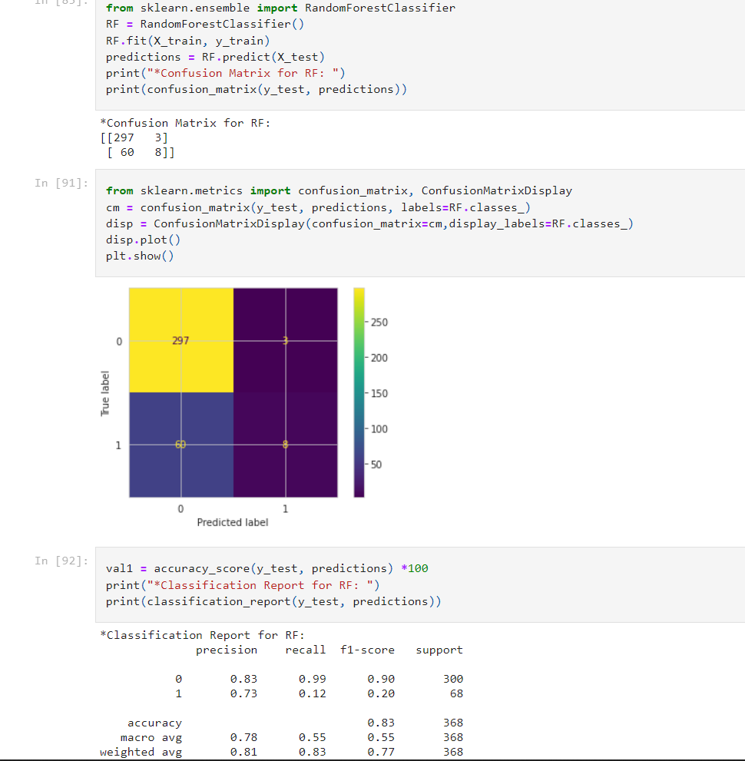
Random Forest Classifier

Slide 25
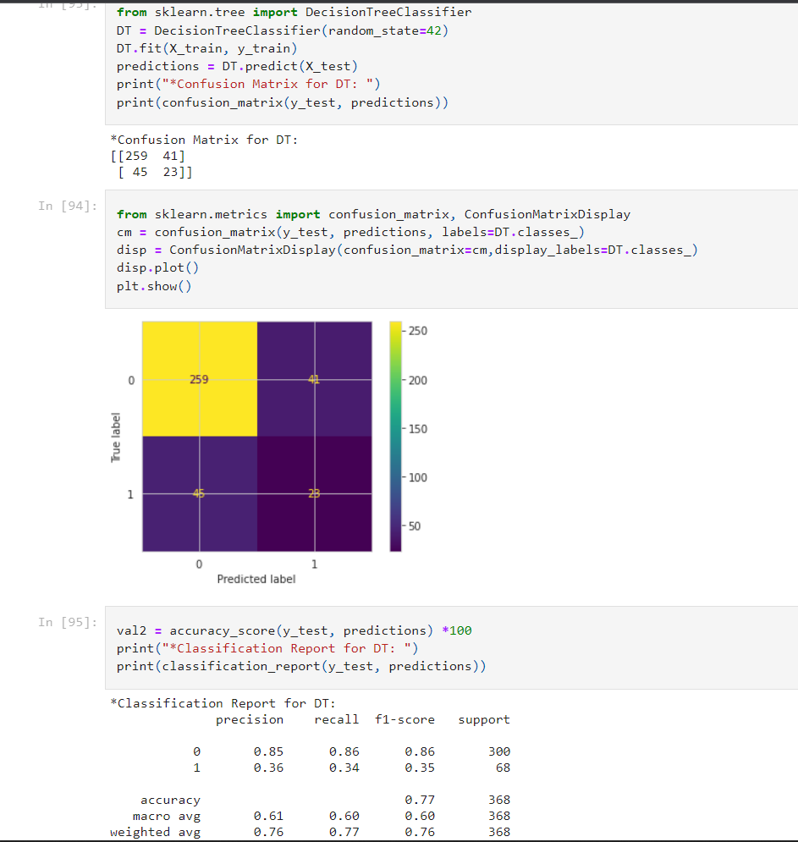
Decision Tree Classifier

Slide 26
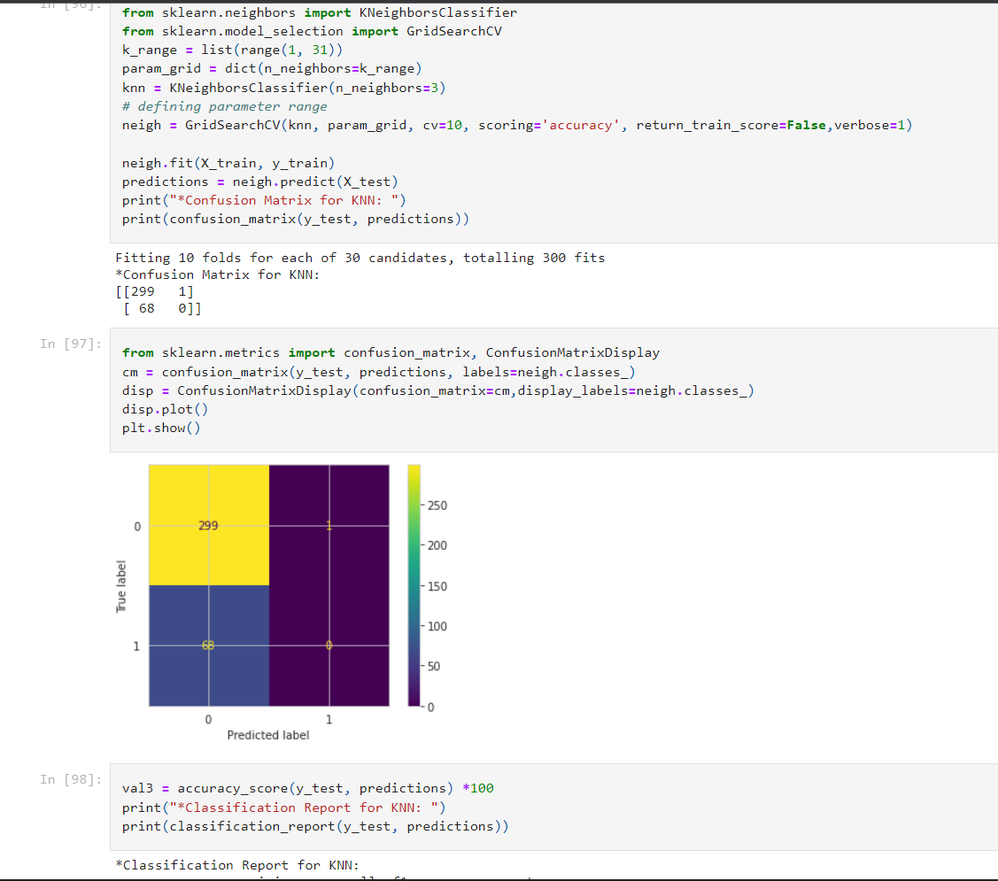
K-Nearest Neighbor

Slide 27
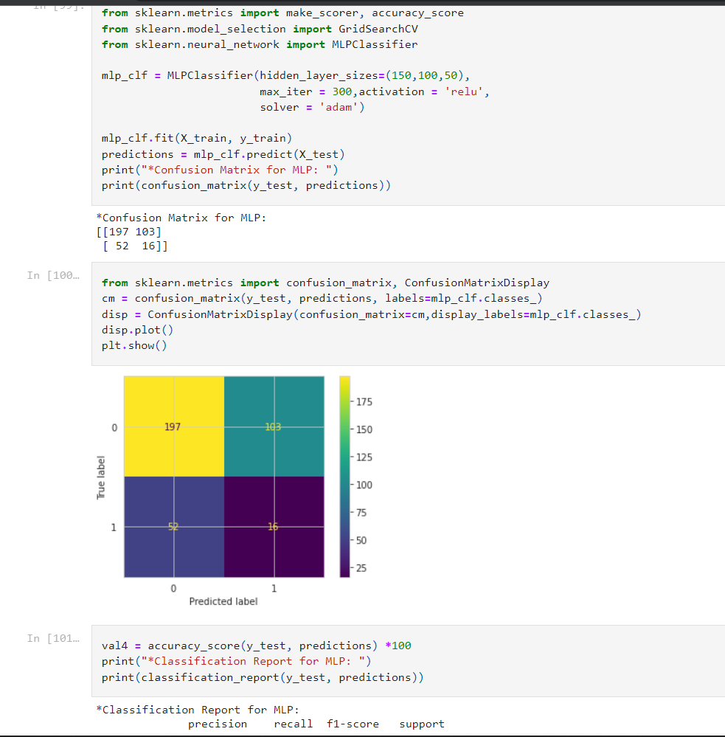
MLP Classifier

Slide 28
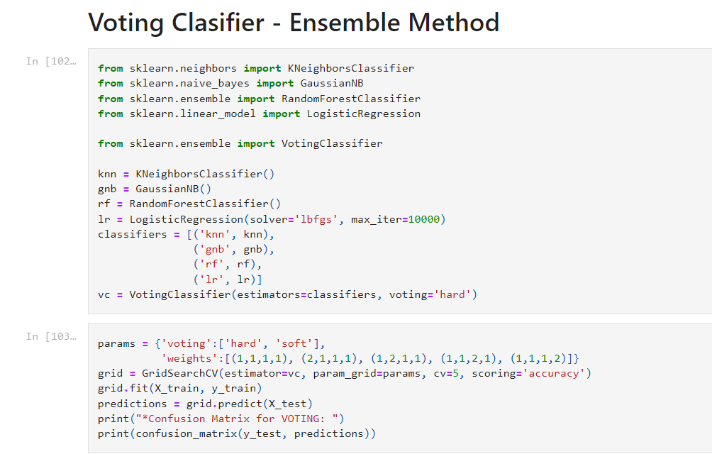
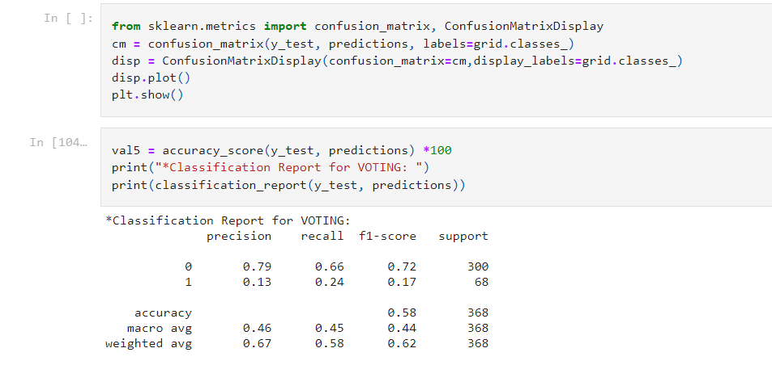
Voting Classifier

Slide 29
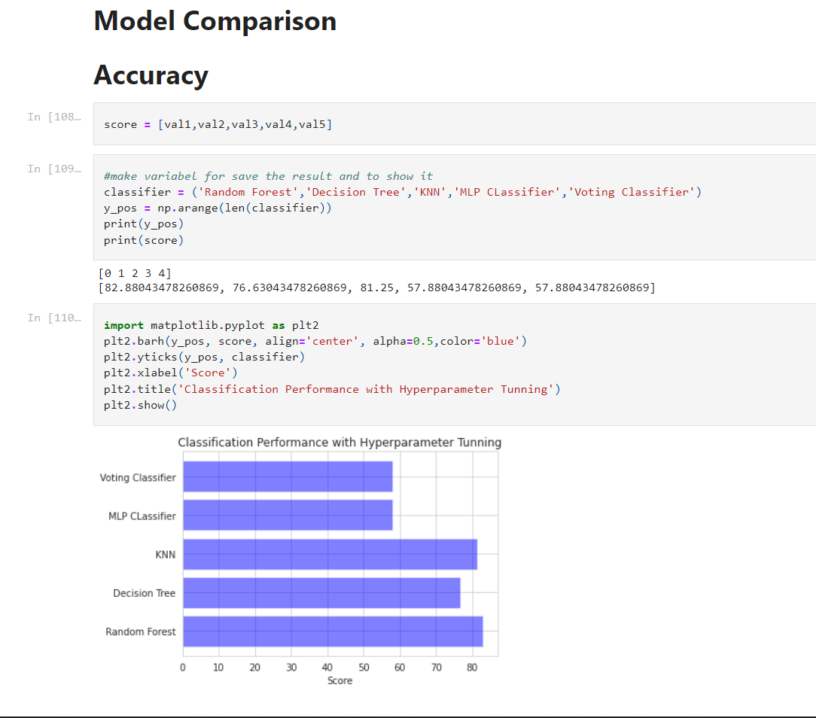
Accuracy Comparison

Slide 30
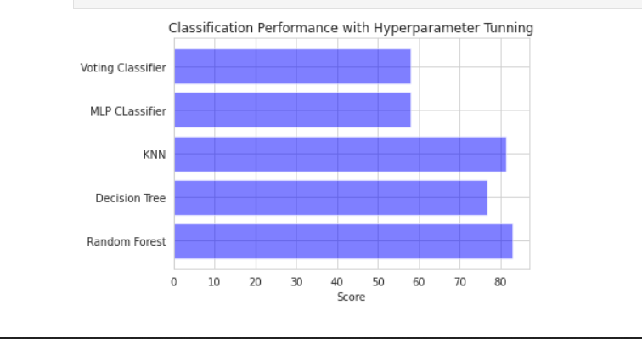

Slide 31
Conclusion
You can see how data analysis using different charts and visualizations helped in getting answers to many questions. We used five various ML algorithms to predict the accuracy of our model. Out of the five algorithms we used KNN and Random Forest Classifier has achieved greater accuracies than other algorithms. These Algorithms help IT firms to concentrate on particular aspects and these are trustworthy because of the accuracies they provide. This analysis will help the company to make some employee policies and modify them if required. Even this will help to make some new employee engagement program that help employee stay more longer.

Slide 32
References
Textbooks:
Programming Python, Mark Lutz
Head First Python, Paul Barry
Core Python Programming,R. Nageswara Rao
Learning with Python, Allen B. Downey
Journals:
[1] Piotr Płoński (MLJAR), “Human-first Machine Learning Platform,” Human Resource Analytics Predict Employee Attrition.
[2] Le Zhang and Graham Williams (Data Scientist, Microsoft), “Employee Retention with R based Data Science Accelarator”.
[3] Ashish Mishra (Data Scientist, Experfy), “Using Machine Learning to Predict and explain Employee Attrition”.
[4] Rupesh Khare, Dimple Kaloya and Gauri Gupta, “Employee Attrition Risk Assessment using Logistic Regression Analysis,” from 2nd IIMA International Conference on Advanced Data Analysis, Business Analytics and Intelligence.
[5] Randy Lao, “Predicting Employee Kernelover,” Kaggle.
Websites:
https://www.w3schools.com/python/
https://www.tutorialspoint.com/python/index.htm
https://www.javatpoint.com/python-tutorial
https://www.learnpython.org/
https://www.pythontutorial.net/

Slide 33


